Slide 1
Finance News research tool
-EQUITY RESEARCH ANALYSIS
-Charu saini (220729)
-Nirbhay(220412)
-Vishal yadav(220612)

Slide 2
BACKGROUND
A finance data anaLyst reviews muLtipLe articLes and newspapers daiLy to anaLyze the stock market.
This process is time-consuming, and cruciaL
information may sometimes be missing, impacting criticaL financiaL decisions.

Slide 3
PROJECT GOALS
DeveLop a chatbot that accepts muLtipLe articLe and newspaper Links, extracts reLevant information, and provides accurate finance anaLysis based on user queries.
Enhance Research Efficiency: StreamLine the information retrievaL process for anaLysts, reducing the time spent manuaLLy reading Lengthy articLes and reports.
ReaL-WorLd AppLication: VaLidate the tooL in reaL- worLd scenarios, demonstrating its vaLue to firms engaged in equity research and investment anaLysis, thus enhancing decision-making capabiLities.

Slide 4



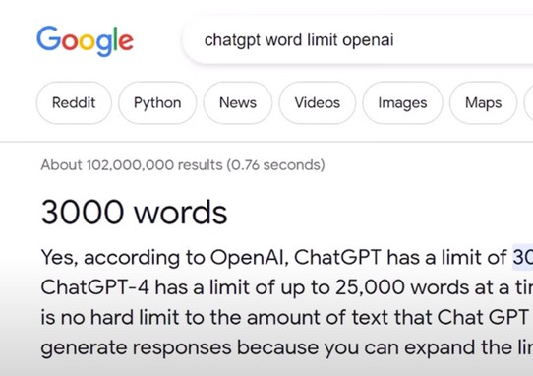


Three Issues with Using ChatGPT
Tedious Manual Input:
Analysts need to
copy and paste articles into ChatGPT, which is time-consuming and inefficient for handling extensive research.
No Aggregate Knowledge Base: ChatGPT cannot maintain a comprehensive knowledge base, making it difficult for analysts to locate responses effectively across multiple articles.
Token Limit Constraints: ChatGPT enforces strict token limits, restricting the size of articles that can be processed, which could lead to incomplete analyses for complex queries.

Slide 5


TOOLS AND TECHNIQUES
This project uses LangChain
OpenAI API/ Hugging face LLM
StreamLit
TooLs
CoLab Notebook Jupyter notebook

Slide 6
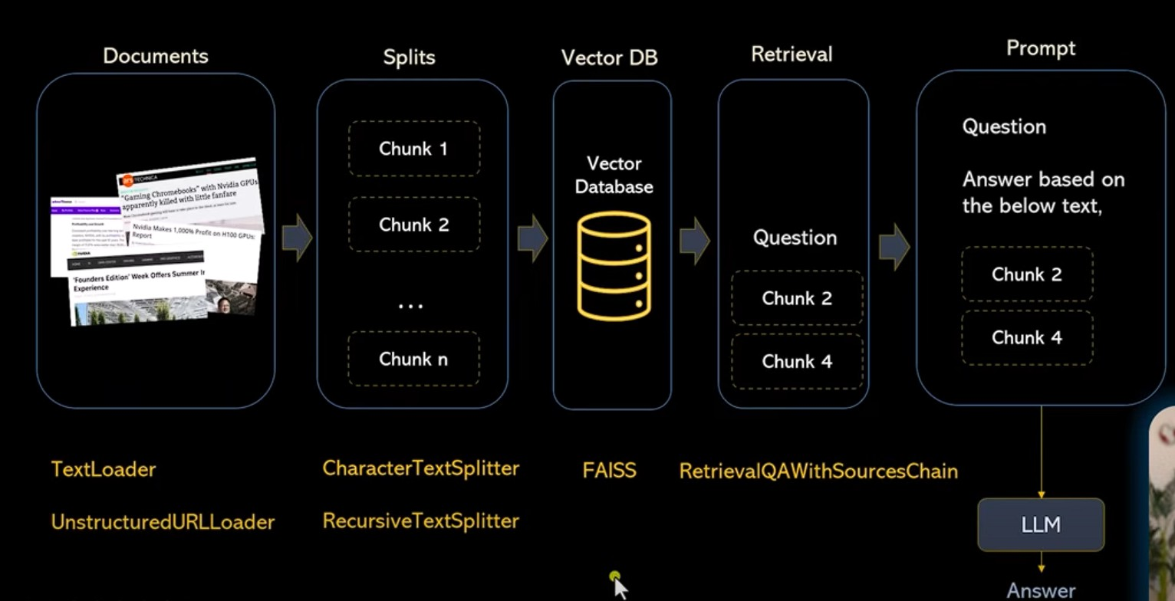
METHODOLOGY

Slide 7
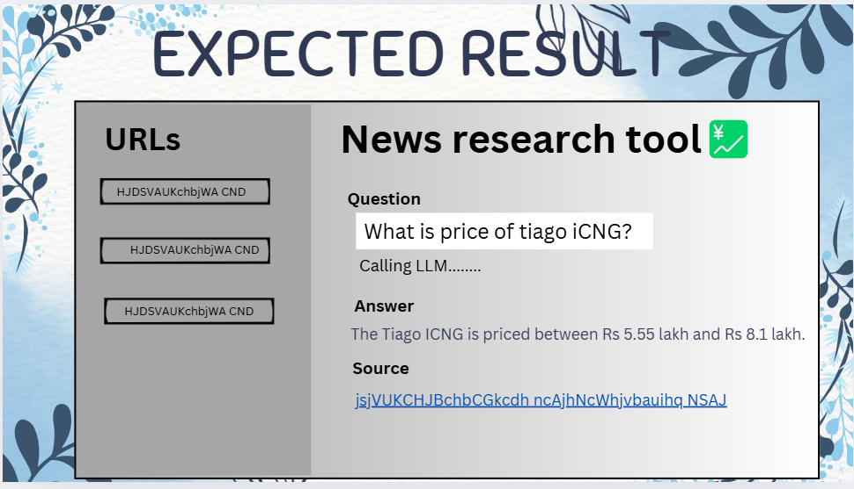

Slide 8
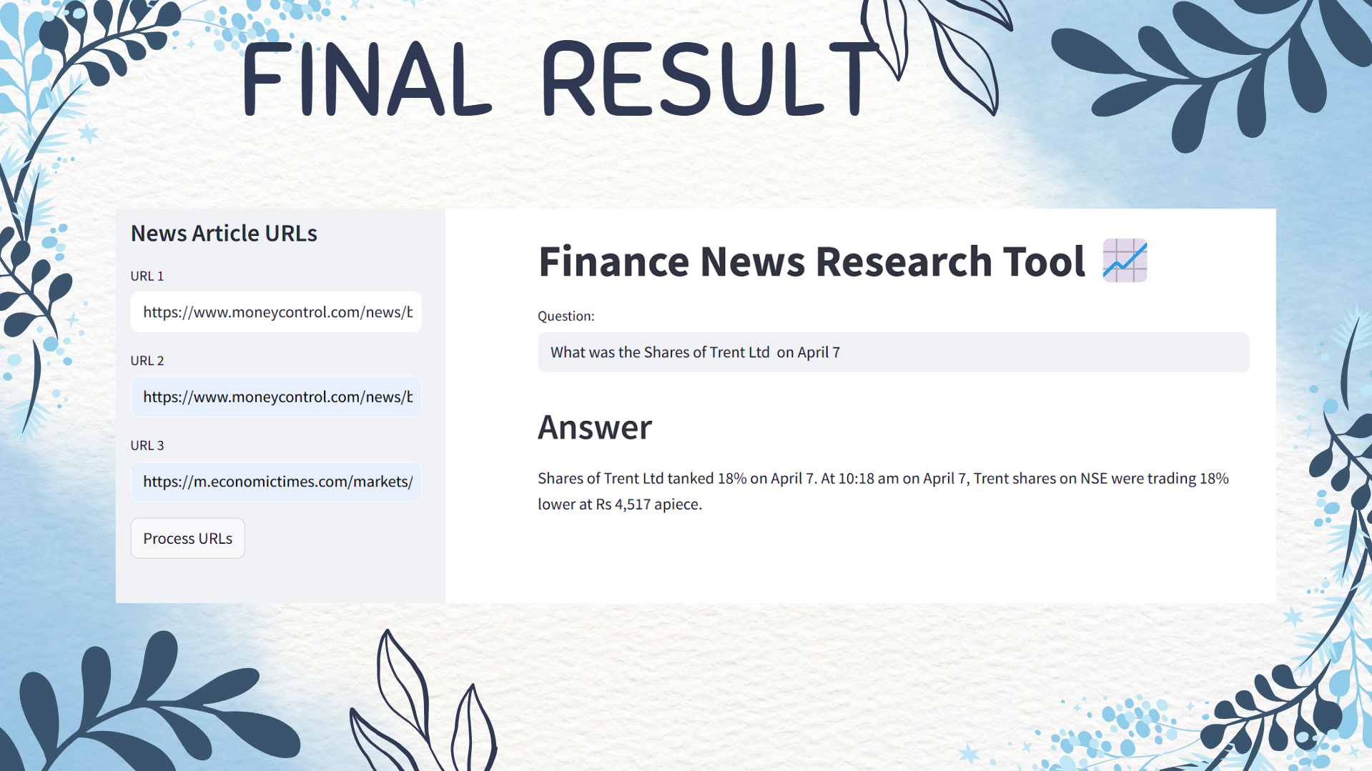

Slide 9
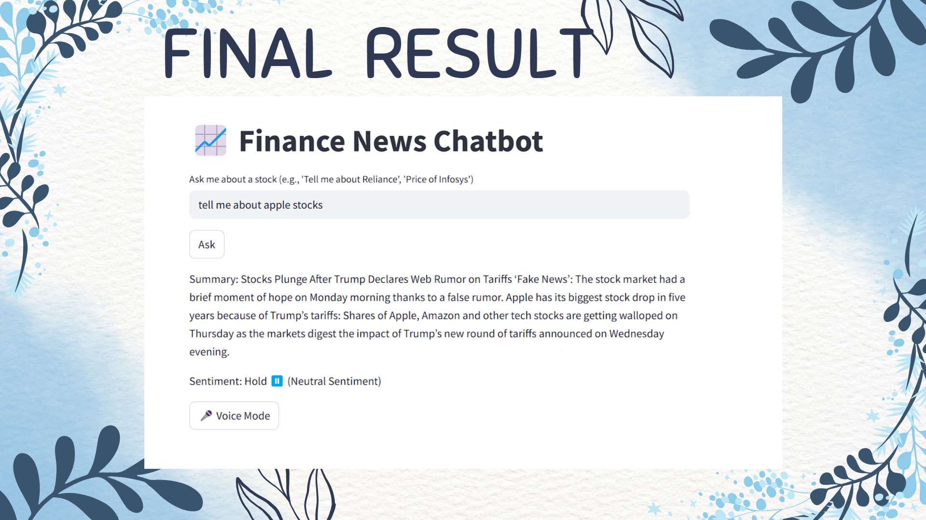

Slide 10
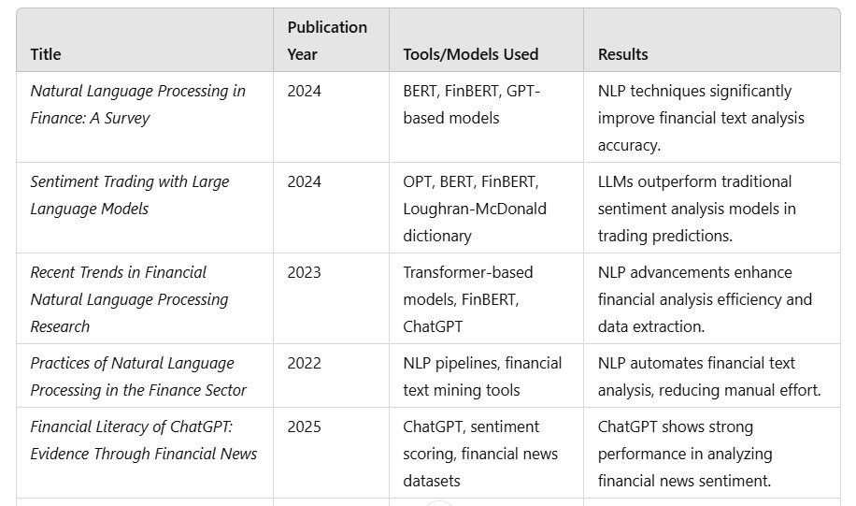
LITERATURE REVIEW

Slide 11
THANK YOU

